Slide 1
Uk Railway system
Project proposal
Journey Through Britain

Slide 2


Team Member
Round :
2
Group :
CAI2_AT1_G6
Supervision :
Eng. Ahmed Samir
Dina Sherif
George Ayad
Sara samy
Marwa Adel
Hoda Gamal
Ahmed Saad

Slide 3






Table of contents
01
02
03
Data Exploration
Data Modeling
Data Cleaning
04
Analysis Questions & Answers
05
Forecasting
06
Visualization Dashboard
07
Recommendation

Slide 4





Tool Used
Power BI
Tableau
Python
SQL
Excel
creating interactive dashboards (Bonus)
creating interactive dashboards
data cleaning, transformation, forecasting
database design, normalization, and query execution.
Data exploration, validation and structuring.

Slide 5
01
Data Exploration
What Is Going on ?

Slide 6

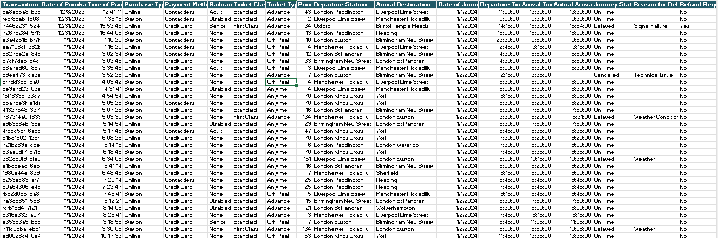




Dataset

Slide 7
Exploration Result
Number of records 31 k
Number of columns 17
This Data represent a 4 month of Reservation.
Data is mostly clean some records need to be fixed and then data can provide a valuable insights.
There aren’t any Outliers this mean that data will provide accurate insights
Most of the data consists of categorical values, and the only column with numerical data is price

Slide 8
02
Data Cleaning & Preprocessing
What Is Going on ?

Slide 9
Cleaning & preprocessing Process
Removing Duplicates
Check for Outliers
Add Columns
Standardizing Formats
Check & Handling Spelling Errors
Missing Values

Slide 10
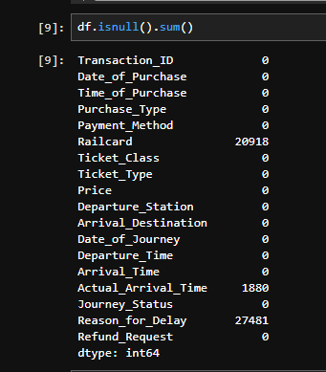
Missing Values
Reason for Delay -> No Delay
Actual Arrival Time -> canceled Journey
So Null Values Here Is Logically Correct and no changes needed
Railcard -> Changed To No Railcard

Slide 11
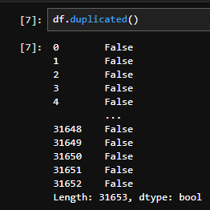
Removing Duplicates
Checked for duplication in each transaction.
“No duplication found.”

Slide 12
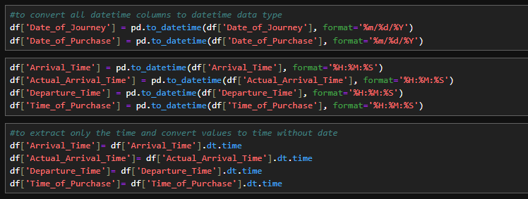
Standardizing Formats
Converted dates to YYYY-MM-DD and times to HH:MM:SS

Slide 13
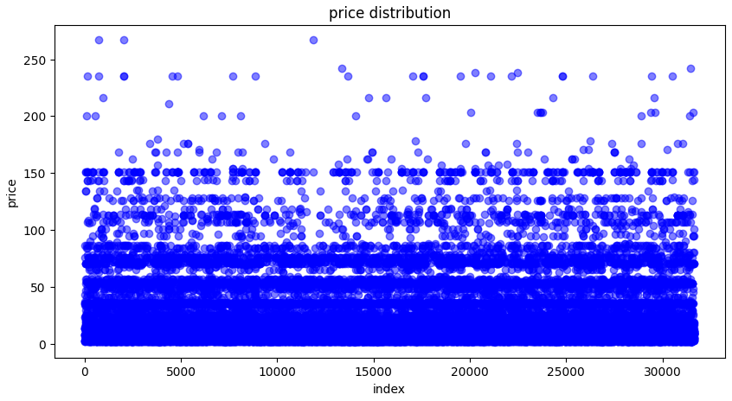
Check for Outliers
Filtered price outliers using IQR
“No Outliers found.”

Slide 14
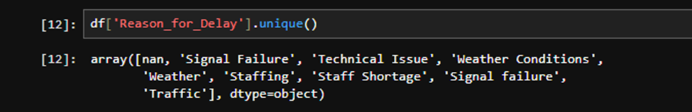
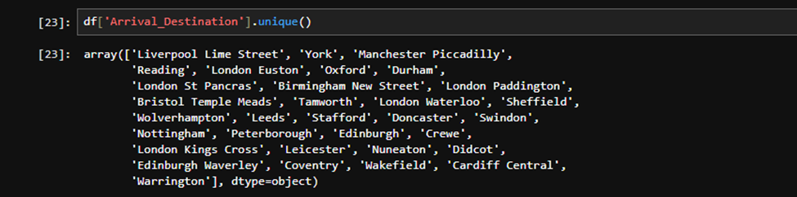
Check for Spelling errors
found similar words in the data.
In "Reason for Delay": weather / weather conditions
staffing / staff shortage & Signal Failure / Signal failure
In "Arrival Destinations": Edinburgh / Edinburgh Waverley

Slide 15
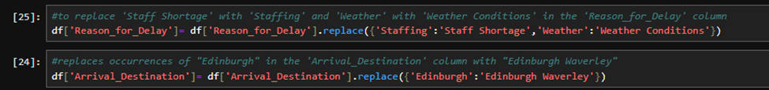
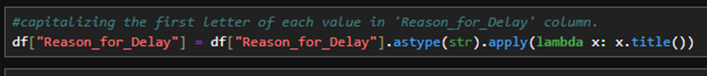
Handling Spelling Errors
in "Reason for Delay": weather → weather conditions , staff shortage → staffing , Signals failure → Signal Failure
In "Arrival Destinations": Edinburgh → Edinburgh Waverley

Slide 16
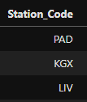
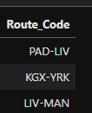
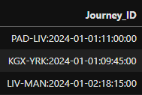
Add Columns
Added essential key columns to ensure each record can be uniquely identified and properly linked. These key columns include:
Journey ID: A unique identifier for each journey.
Station Code: A unique identifier for each station
Route Code: A unique identifier for each route.

Slide 17
03
Data Modeling
Will the data provide good result ?

Slide 18
Data Modeling
Divided the data into four tables to better organize and manage the information. Each table holds specific details:
1.Journeys: Stores information about each journey.
2. Routes: Contains details about the different routes.
3. Transactions: Holds the transaction data related to each journey.
4. Station: Lists the stations involved in the journeys.
linked these tables together using primary keys and foreign keys, ensuring efficient relationships and minimizing redundancy.

Slide 19
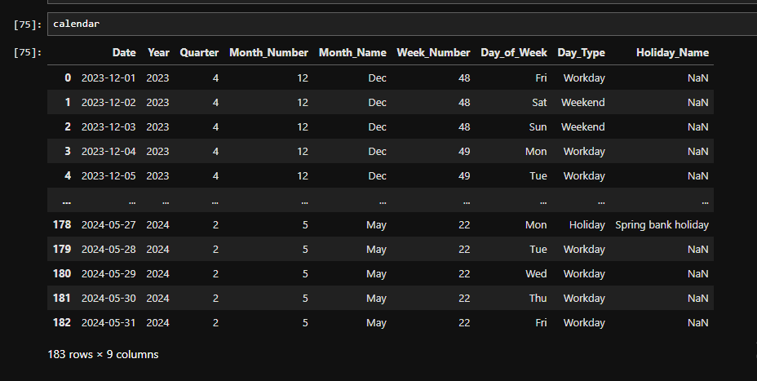
Calendar Table
Added a Calendar table. This table helps manage and track dates efficiently, ensuring that time-based analysis can be performed smoothly. The Calendar table links to other tables through date-related columns,

Slide 20
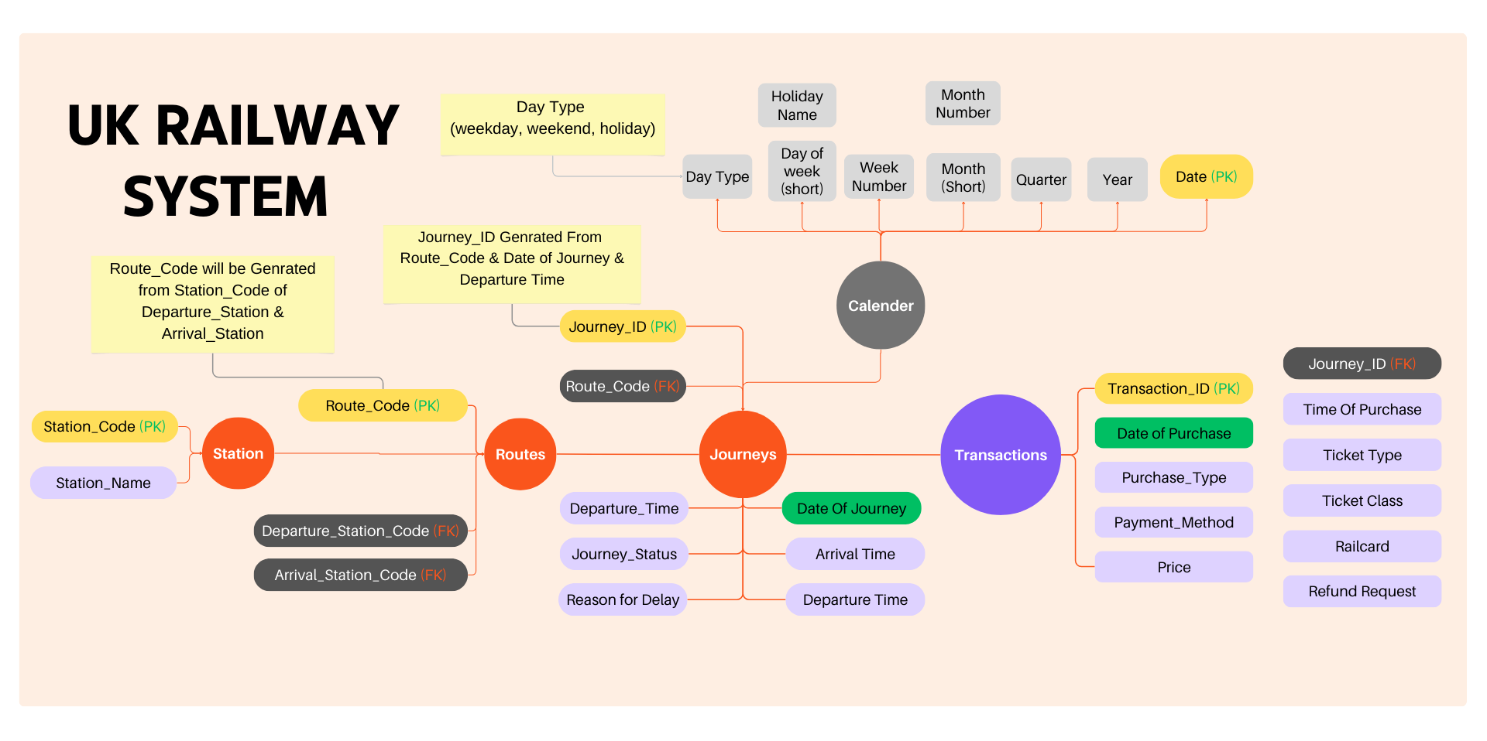
Modeling

Slide 21
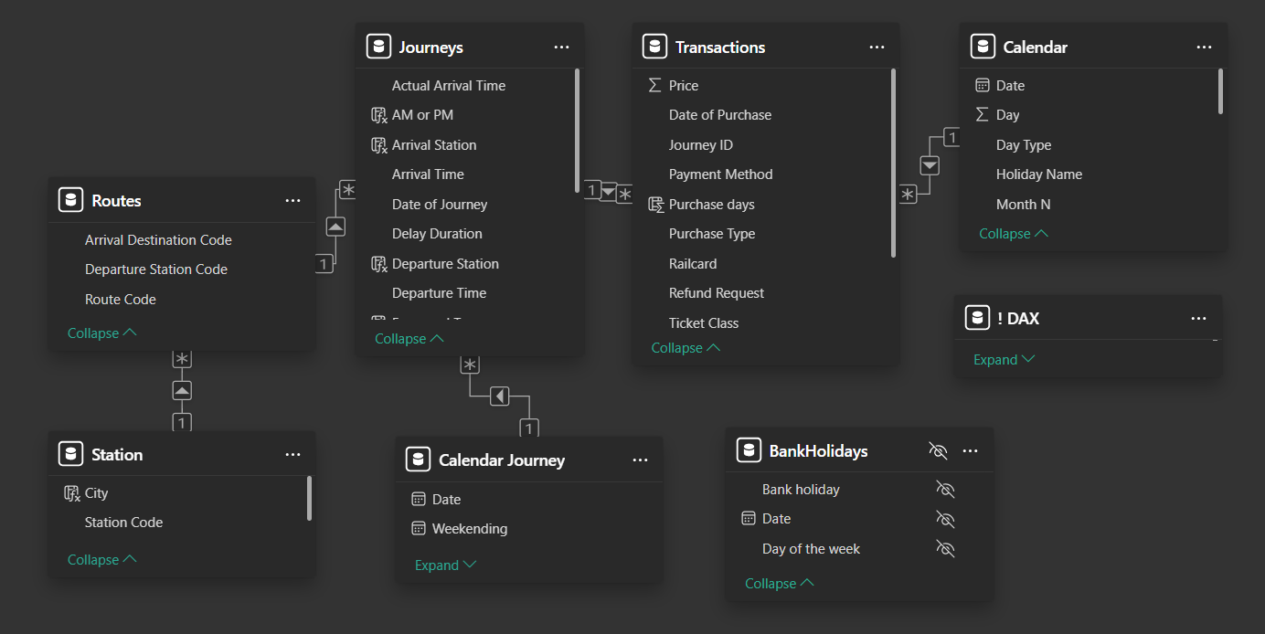
Final Data Model

Slide 22
04
Analysis Questions
What need to be answered ?

Slide 23



Analysis Questions
Passenger Performance
What is the number of Tickets sold?
What is the most Payment Method?
What is the most common Ticket Type?
What is the most common Ticket Class?
What is the Number of online Transactions vs station Transactions?
What percentage of customers use railcard?
What is the number of Tickets per Month?
What are the Numbers of Passenger per Day?
What is the Average Number of Transactions per Day Type?
What are the Numbers of Passenger per Hour?

Slide 24
Analysis Questions
Railway Performance
What is the total number of Journeys?
What is the total number of Journeys On Time?
How many journeys are delayed?
How many journeys are cancelled?
How is Journeys distributed by Journey per month?
What is the number of Journeys On Time per Month?
What is the Reliability Score for On Time Journeys?
What is the number of Journeys per Day?
How were journeys distributed by delay reasons?
Number of Transactions on Cancelled and Delayed Journeys + Refunds of Them
What is the Average Number of Journeys per Day Type?
What is the average delay duration?

Slide 25
Analysis Questions
Sales Analysis
What is the total revenue and net revenue?
What is the total refund?
What is the average ticket price?
What is the top 5 Routes by Revenue?
What is the bottom 5 Routes by Revenue?
How is revenue distributed by payment method?
How is revenue distributed by Purchase Type?
How are ticket sales distributed by ticket type?
What is the monthly Trend of Net Revenue?
What is the Average Net Revenue per Day Type?
What is the Net Revenue by Journey Statues?
What is the Impact of Delay Time on refund?
What is the total refund by journey statues?

Slide 26
Analysis Questions
Routes & Stations Analysis
What is the number of Routes ?
What is the number of Departure Stations?
What is the number of Arrival Stations?
What are the top 5 routes with highest percentage of delays?
What are the top 5 routes with highest percentage of cancellations ?
What is the top 5 of used Departure?
What is the Bottom 5 of used Departure Stations?
What is the top 5 of used Arrival Stations?
What is the Bottom 5 of used Arrival Stations?
What is the top 5 Routes of number of journeys?
What is the bottom 5 Routes of number of journeys?

Slide 27
05
Visualization

Slide 28

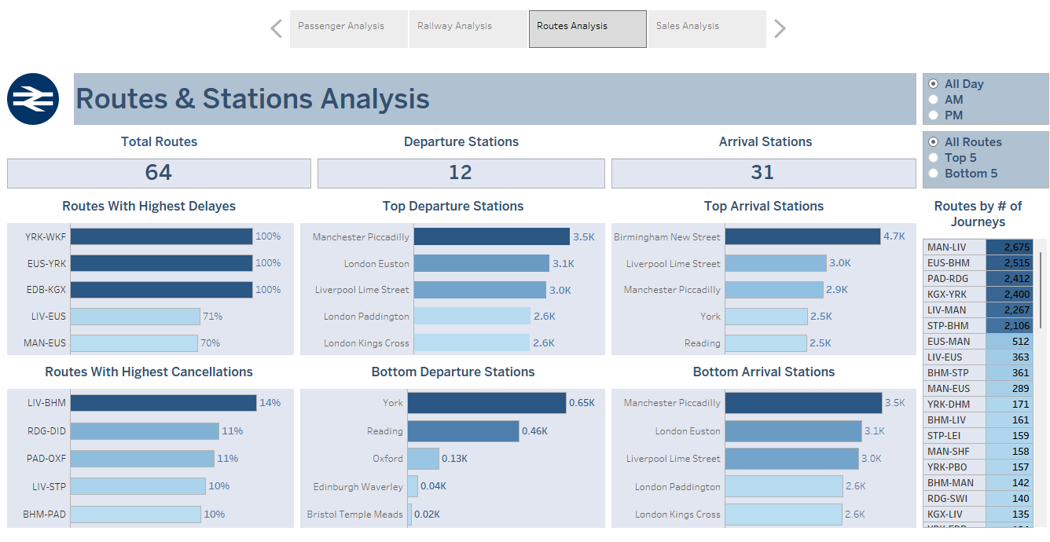
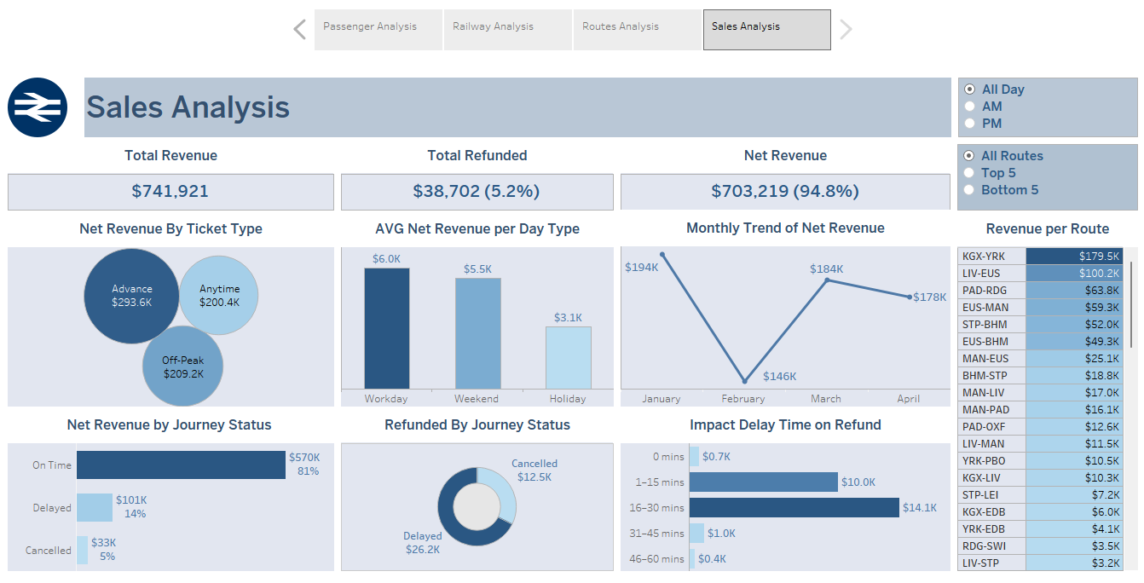
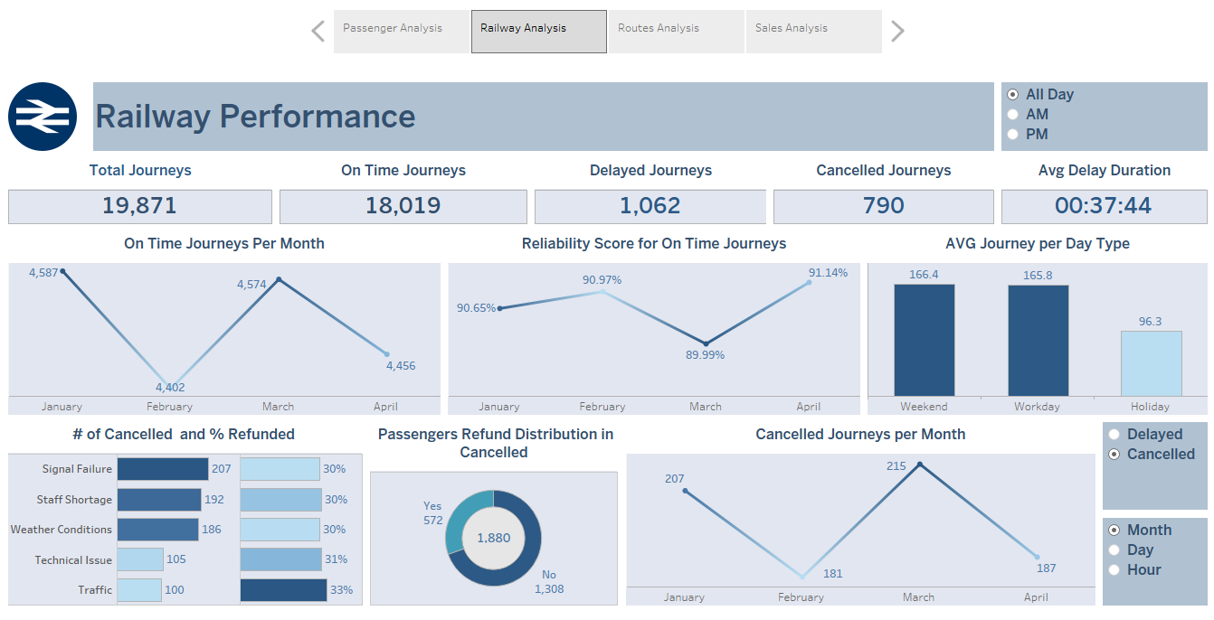
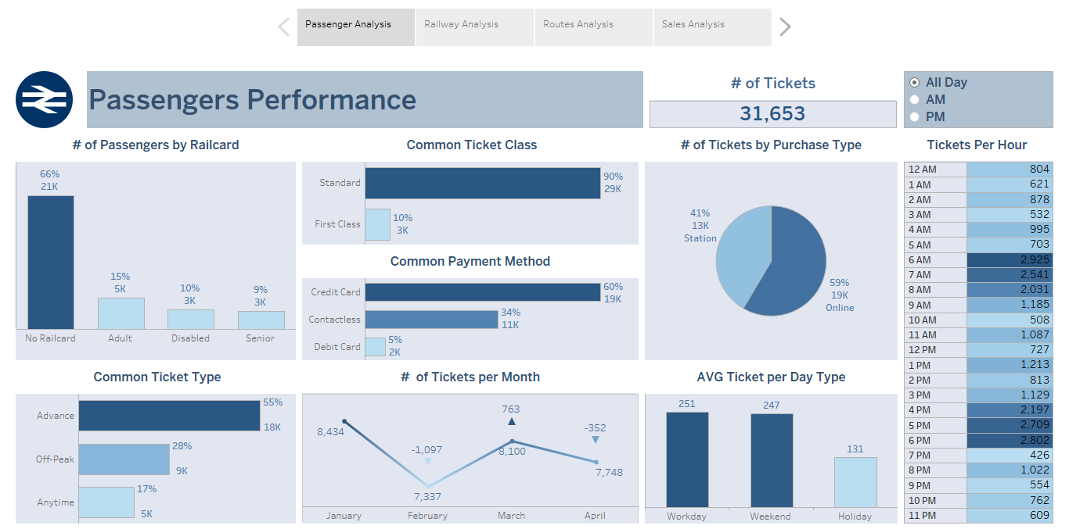
Tableau

Slide 29
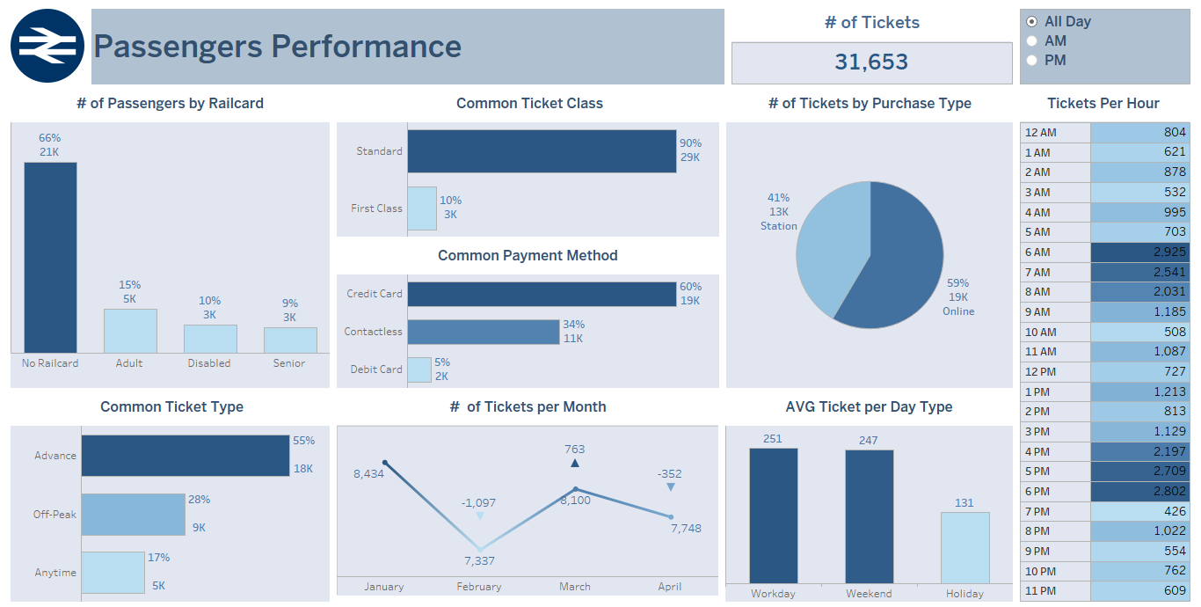
Passengers Performance Dashboard

Slide 30
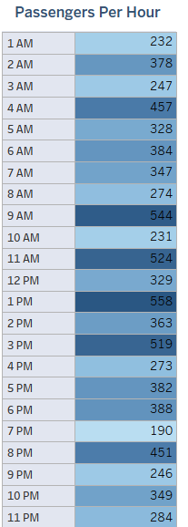
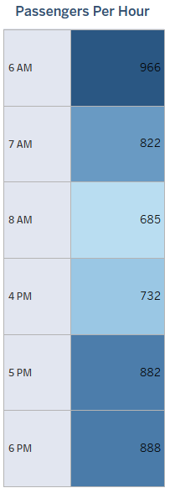
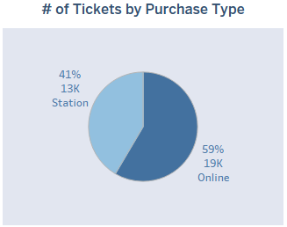
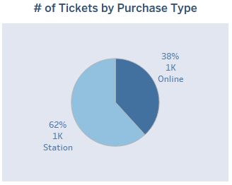
Dashboard Insights
Even though the Anytime Ticket Type can be used in any time in the day the people use it in the peak hours and mostly in Weekday
Peak Hours are 6-8 AM, 4-8 PM and when being filtered by Off Peak Ticket Type it transform to other times because of it’s condition for being used out of Peak Hours but still there is Tickets being used in it and it is related to the fact that the Peak Hours Ticket only ably in the Weekdays
Filtered by Debit Card
The common purchase type is Online with Almost 60% of People buy Tickets Online with different type of payment method except debit card with Almost 60% of people buying with it in Station

Slide 31
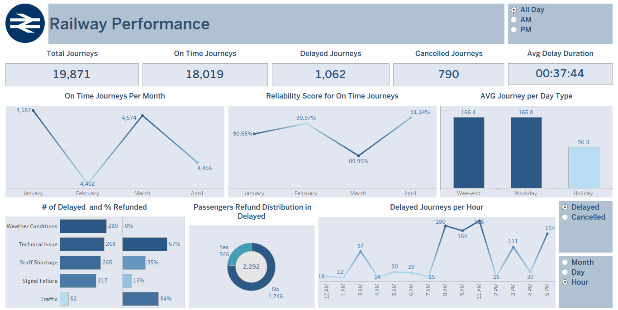
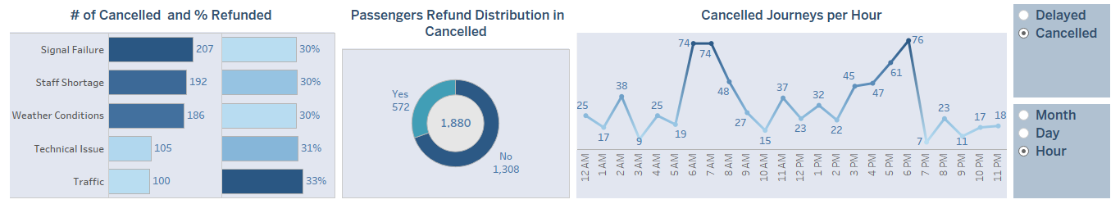
Railway Performance Dashboard

Slide 32
Sales & financial Analysis
Revenue
Net Revenue
Refund 5%

Slide 33
Sales & financial Analysis
Revenue
$741K
Net Revenue
Refund 5%

Slide 34
Sales & financial Analysis
$741K
Revenue
$703K
Net Revenue
Refund 5%

Slide 35
Sales & financial Analysis
$741K
Revenue
$703K
Net Revenue
Refund 5%
$39K

Slide 36
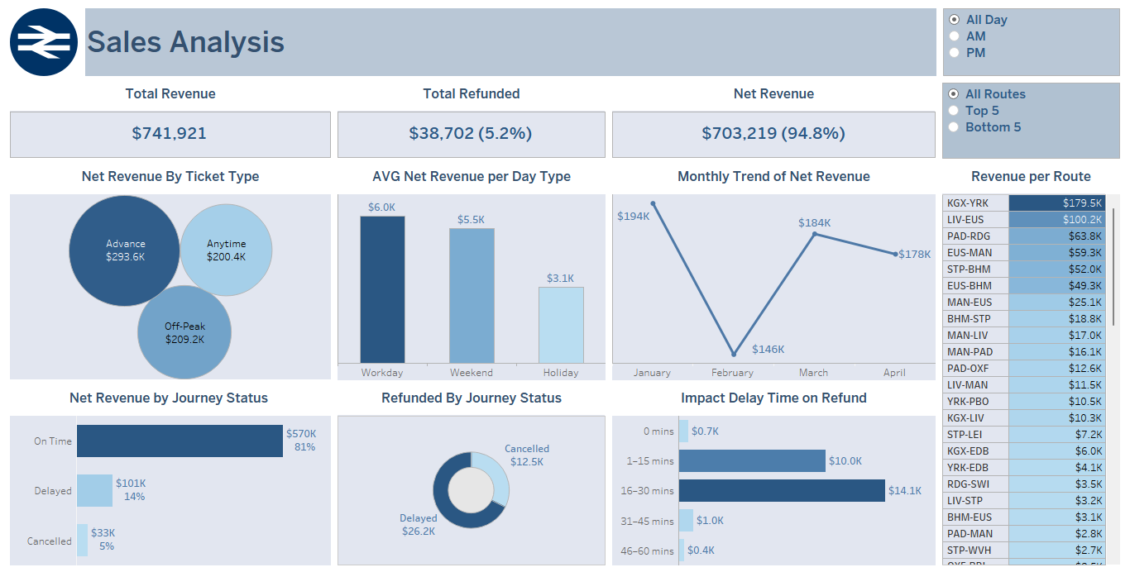
Sales Analysis Dashboard

Slide 37
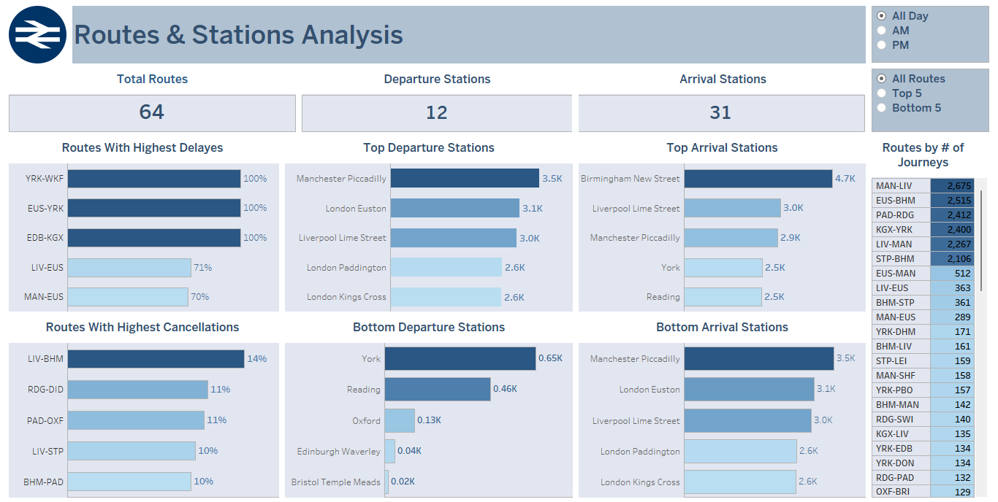
Routes & Stations Analysis Dashboard

Slide 38
troublesome City
Delay percentage
Refund percentage
Reason of delay

Slide 39
troublesome City
491 of 1602 delay in London city with 31% delay percentage
Delay percentage
Refund percentage
Reason of delay

Slide 40
troublesome City
Delay percentage
491 of 1602 delay in London city with 31% delay percentage
Refund percentage
$26K out of $200K revenues with 13.2% refund percentage
Reason of delay

Slide 41
troublesome City
Delay percentage
491 of 1602 delay in London city with 31% delay percentage
Refund percentage
$26K out of $200K revenues with 13.2% refund percentage
Reason of delay
58% of delay reasons because of the weather

Slide 42
troublesome Route
Delay percentage
Refund percentage
Reason of delay

Slide 43
troublesome Route
362 of 1602 delay in Liverpool to London journey with 56% delay percentage
Delay percentage
Refund percentage
Reason of delay

Slide 44
troublesome Route
Delay percentage
362 of 1602 delay in Liverpool to London journey with 56% delay percentage
Refund percentage
$13K out of $113K revenues with 15.6% refund percentage
Reason of delay

Slide 45
troublesome Route
Delay percentage
362 of 1602 delay in Liverpool to London journey with 56% delay percentage
Refund percentage
$13K out of $113K revenues with 15.6% refund percentage
Reason of delay
63% of delay reasons because of the weather

Slide 46

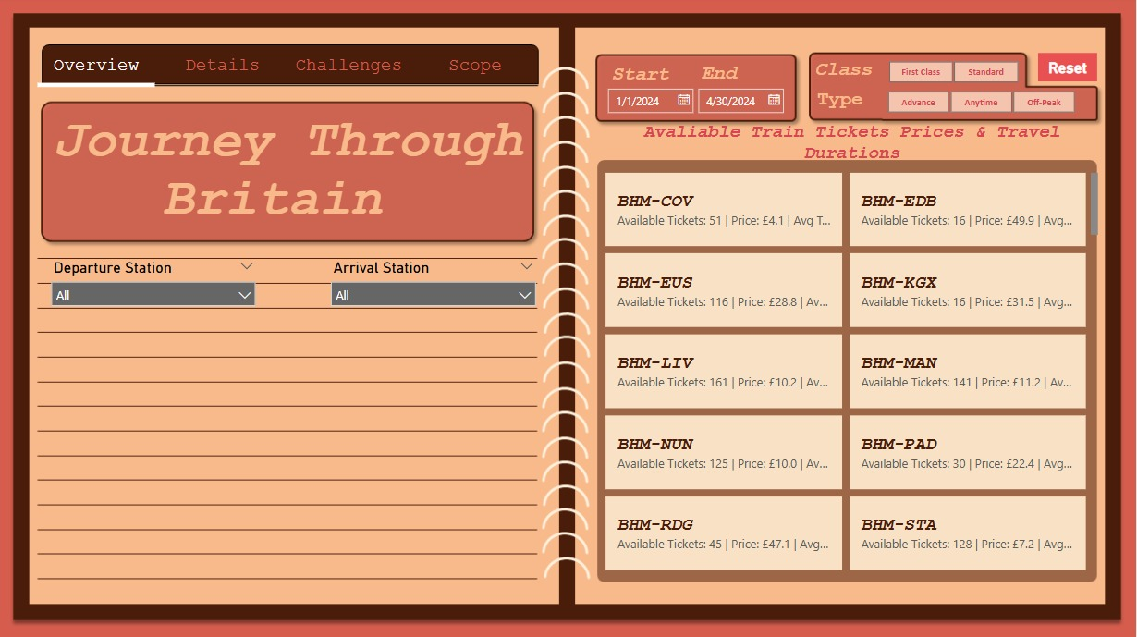
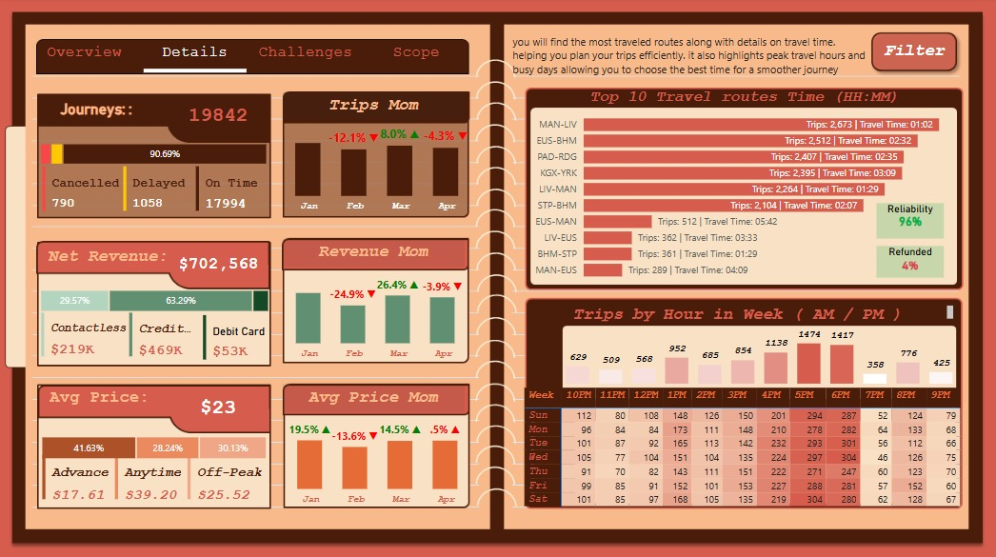
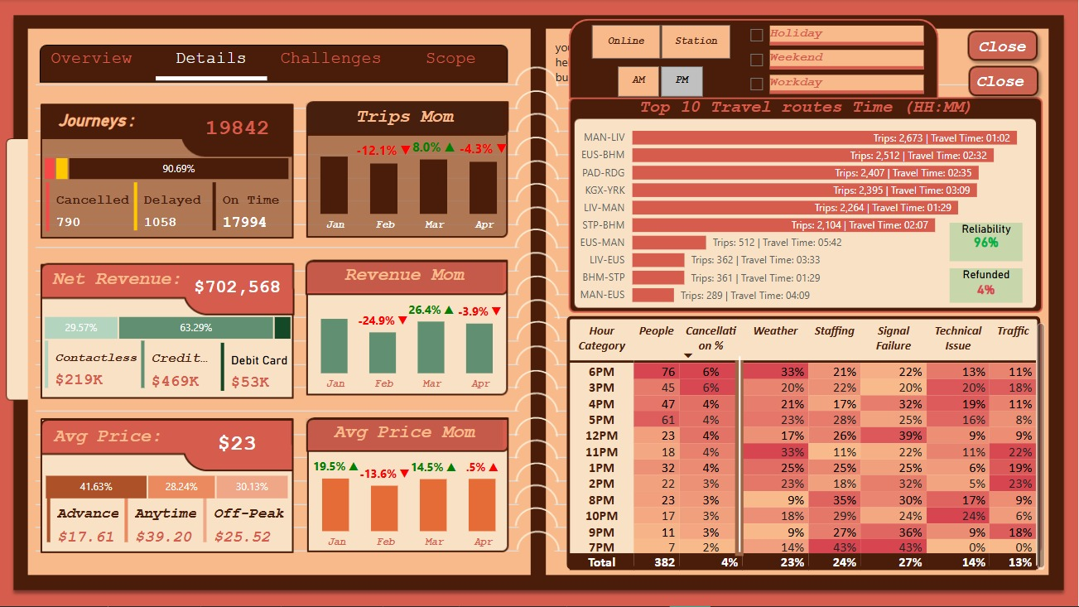
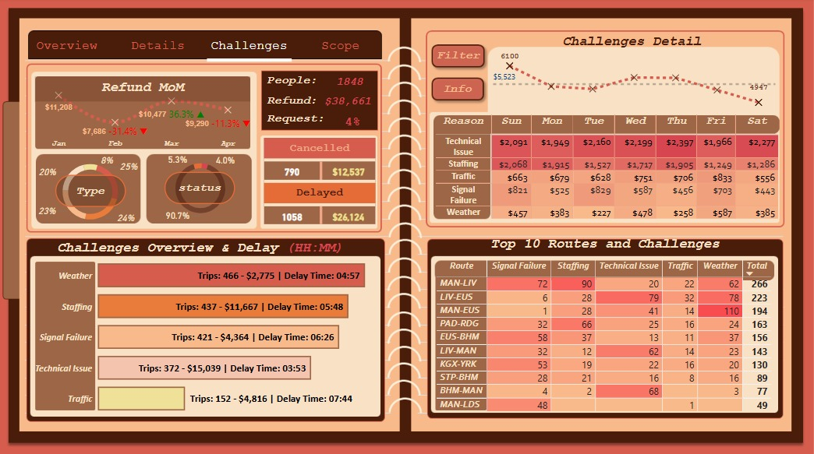
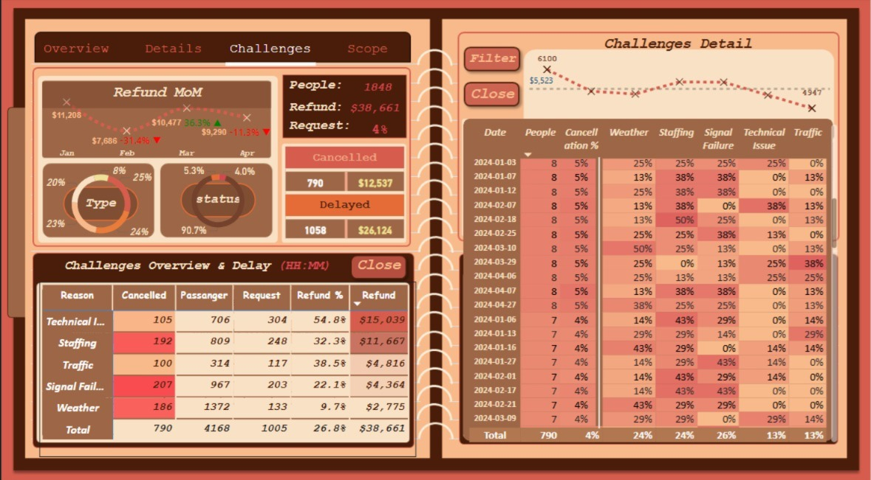
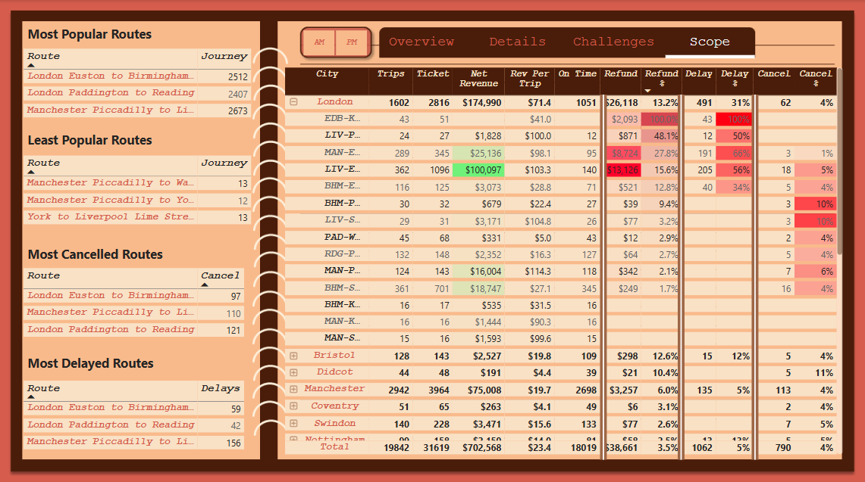
Power BI

Slide 47
06
Forecasting

Slide 48
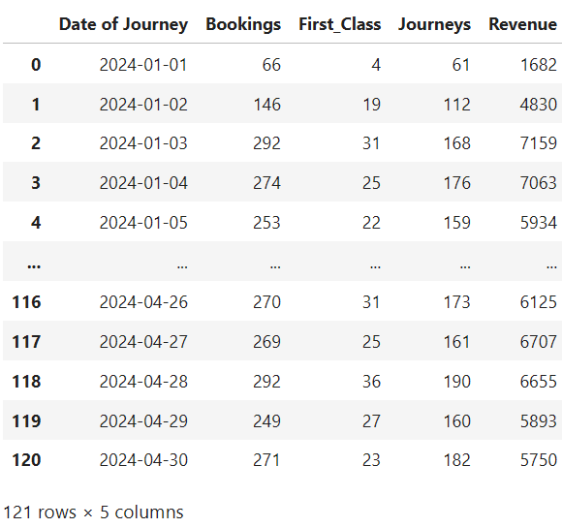
Transforming Cleaned Data into Actionable Metrics
Input: Cleaned dataset following the data cleaning and preprocessing stage.
Next Step: Aggregate daily records to derive meaningful operational metrics.
Key Metrics:
Total Bookings
Total Journeys
Total Revenue
First-Class Reservation Counts

Slide 49
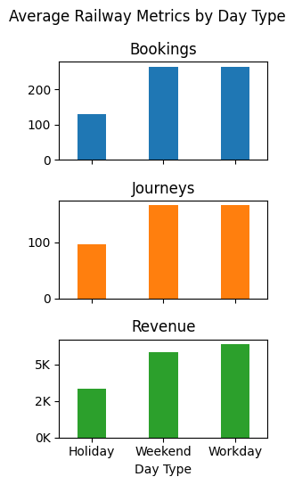
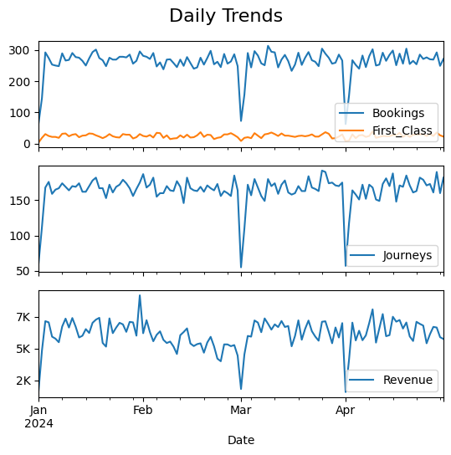
Data Exploration
Observation:
Notable drops in daily trends detected.
Insight:
These drops align with public holidays.
Action:
Include holiday flags as input features in the prediction model.

Slide 50
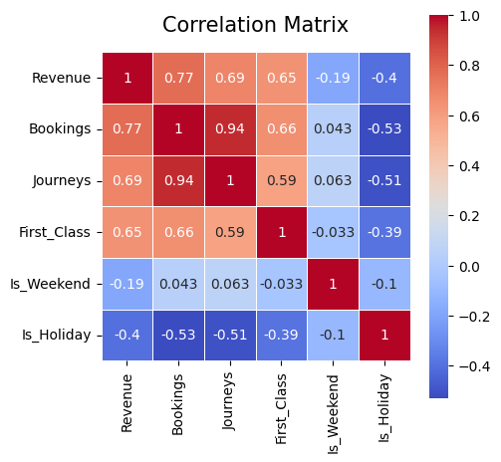

Transforming Cleaned Data into Actionable Metrics
📥 Import:
Calendar table including official public holidays
⚙️ Action:
Merge holiday and date-related columns into the main dataset
Encode binary flags for:
Holidays
Weekends
🔍 Explore:
Plot a correlation matrix to identify significant relationships between features.
Weekends

Slide 51
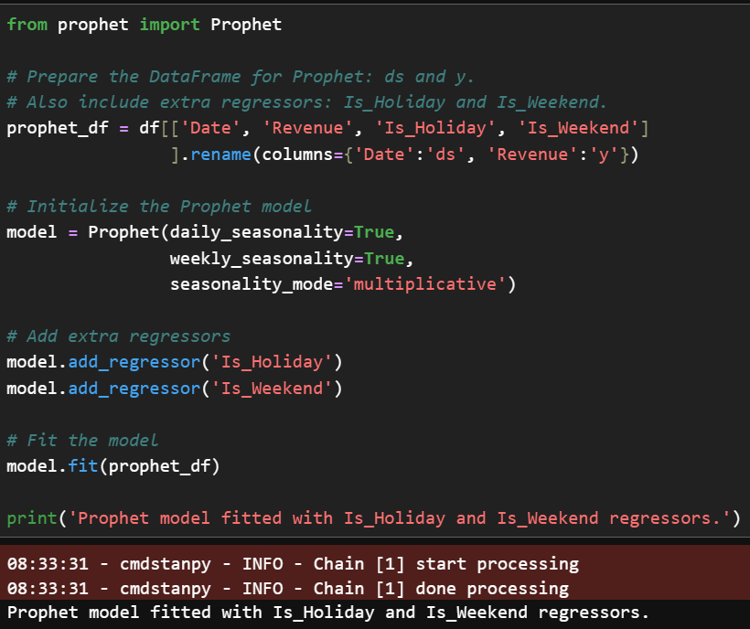
Building the forecasting model using Prophet
✅ Prophet from Meta:
Effectively captures multiple seasonal patterns (daily, weekly, yearly).
Supports inclusion of external factors (e.g., weekends, holidays).
Intuitive and interpretable components: trend, seasonality, holiday effects.
A suitable fit for our case, given the clear influence of holidays and recurring patterns in the data.

Slide 52
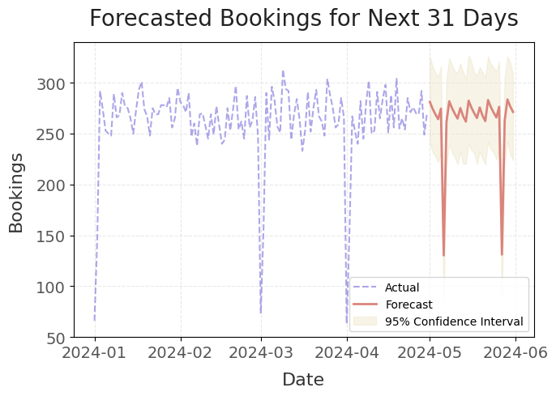
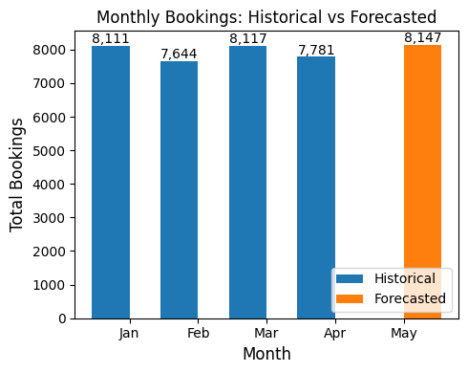
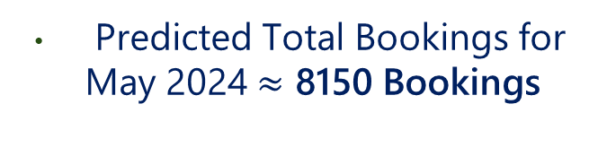
Forecasting May Bookings
Predicted Total Bookings for May 2024 $≈$ 8150 Bookings

Slide 53
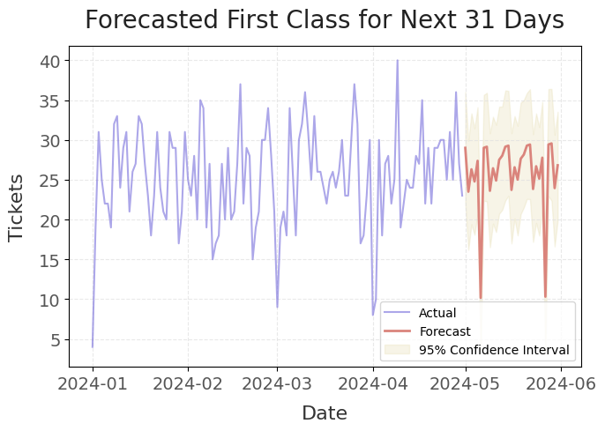
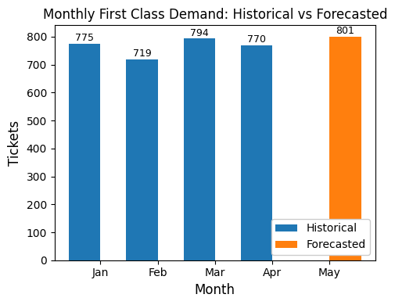

First Class Demand next month (May 2024)
Predicted Total First Class for May 2024 $≈$ 800 Tickets

Slide 54

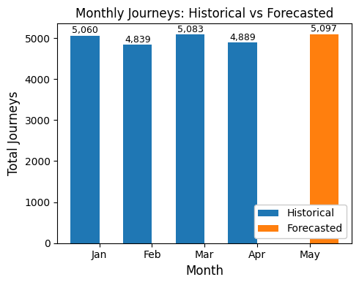

Forecasting May Journeys
Predicted Total Journeys for May 2024 $≈$ 5100 Journeys

Slide 55
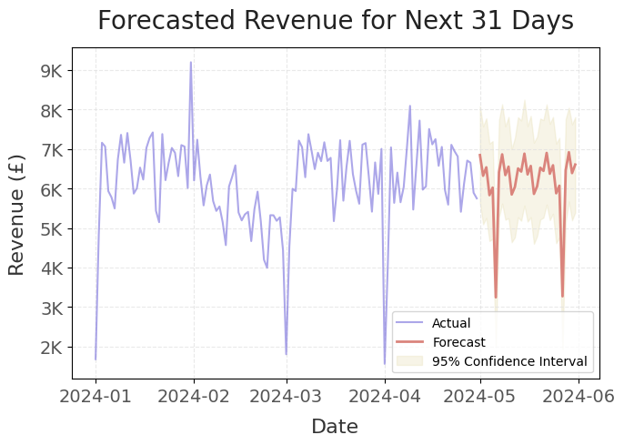
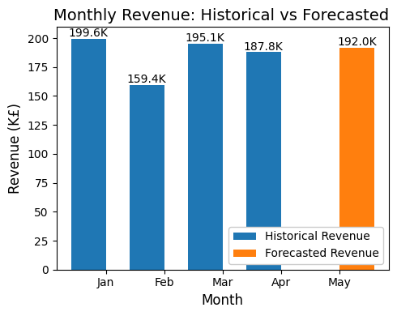

Building the forecasting model using Prophet
Predicted Total Revenue for May 2024 $≈$ 192k £

Slide 56
Performance Overview: Daily Bookings Forecast
📊 Key Metrics:
RMSE: 25.2
Predictions deviate by ~25 bookings on average
Relative error: ~ 8-10 % (based on avg. 260–290 bookings/day)
MAE: 19.9
On average, predictions are off by ~20 bookings in either direction
MAPE: 8.27%
Forecasts are typically within 8.27% of actual values — a solid result for time series forecasting
🔍 Insights:
The forecast displays a stable trend over the next 31 days
Confidence intervals are well-calibrated
Model accounts for weekend and holiday effects, enhancing reliability

Slide 57
07
Recommendation

Slide 58
Recommendations
Immediate
(0–3 Months)
Short-Term
(3–6 Months)
Long-Term
(6+ Months)
Holiday Scheduling

Slide 59
Recommendations
Immediate
(0–3 Months)
Increase Train Frequency: Reduce intervals between trains by 15–20%.
Root Cause Analysis: Audit signals, staffing, and weather protocols.
Test offering partial refunds and flexible pricing.
Revisit Refund Policy if possible (projected savings: $10K/month).
Short-Term
(3–6 Months)
Long-Term
(6+ Months)
Holiday Scheduling
Delay Duration | Refund %
<15 min | 0 %
15 – 30 min | 25 %
30 – 60 min | 50 %
60+ Min | 100 %

Slide 60
Recommendations
Immediate
(0–3 Months)
Boost Staffing: Deploy 30% more staff at top 5 stations (e.g., Manchester Piccadilly).
Real-Time Alerts & Transparent Communication: SMS/app alerts for delays + alternative routes.
Impact:
Target: Reduce delays by 25% in 6 months.
Introduce bundled travel packages
Short-Term
(3–6 Months)
Long-Term
(6+ Months)
Holiday Scheduling

Slide 61
Recommendations
Immediate
(0–3 Months)
Short-Term
(3–6 Months)
Full signal system renovation
AI-driven predictive maintenance
Long-Term
(6+ Months)
Holiday Scheduling

Slide 62
Recommendations
Immediate
(0–3 Months)
Short-Term
(3–6 Months)
Bookings drop 35% on holidays (e.g., Christmas).
Recommendation:
Maintain current reduced trips to match demand.
Long-Term
(6+ Months)
Holiday Scheduling

Slide 63




Thanks!
Do you have any questions?
Please keep this slide for attribution

